Slide 1
E-Tender
A blockchain based Auction system
Alfin Shaji
MCA S3-A
Roll No:13

Slide 2
Relevance of the Topic:
In recent years, electronic bidding (E-bidding) has become an efficient and convenient service to provide an open environment for suppliers to protect the public interest.
But lack of transparency in the tendering process and assigning contracts to agencies has led to unwise use of money and the spirit of speculation in both government as well as private sector.
This project aims to bring transparency in this system by making the records of tenders public using Blockchain technology.

Slide 3
Description of the topic
This is a platform for tender creation and contract assignment process. Through this we attempt to bring transparency in the process using a emerging Block-Chain Technology.
Here when an organization call out a tenders, bidders can place the bids for the items. After the fixed amount of time, the tender will be allocated to the bidders who placed the highest bid amount.
Here the bid amount is stored and transferred as blockchain so that the security of the data will be ensured and no third party is required.

Slide 4
Objective of study
To bring transparency in the tender creation and contract assignment process using a emerging Block-Chain Technology.

Slide 5
Existing system
In the traditional Electronic bidding systems, the seller will sell an item and many buyers will bid for that item and the highest bidder will get the item.
One of the main issue with this E-Bidding system is the introduction of third-party mainly a company or set of companies which will develop and host either the website or smartphone application. The Buyers and the Sellers have to trust this company because all the bidding process will be handled by the company. The company can manipulate the bidding process if it wants.

Slide 6
Proposed System
To avoid the trust issues in tender allocation, a blockchain based electronic bidding system is introduced. In this model, there is no need for third party. Smart Contract will handle all the bidding transactions. Since blockchains are known for its integrity this system makes sure that the integrity of the bidding process is preserved.
Blockchain is a decentralized network in which unreliable peers interact among themselves and perform transactions. So all the data and bidding amounts will be stored in the peer nodes.

Slide 7
Proposed System
Blockchain is known for its tamper-proof mechanism, so no attacker can manipulate the data. It maintains integrity.
In the traditional system, if the third party is down, the whole bidding process will collapse. In blockchain based network even if one node is down, others will hold the data and it will make the system more reliable.

Slide 8
Benefits
Transparency in System
Diminishing Corruption
No one can view bids before closing date
Decentralized Database

Slide 9
Modules
Auction creation
Placing bids
Auction allocation

Slide 10
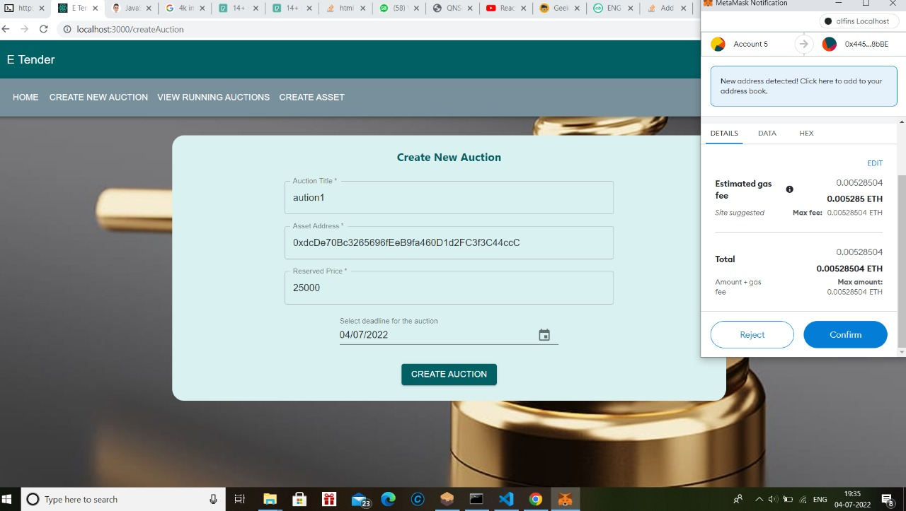
Auction Creation

Slide 11
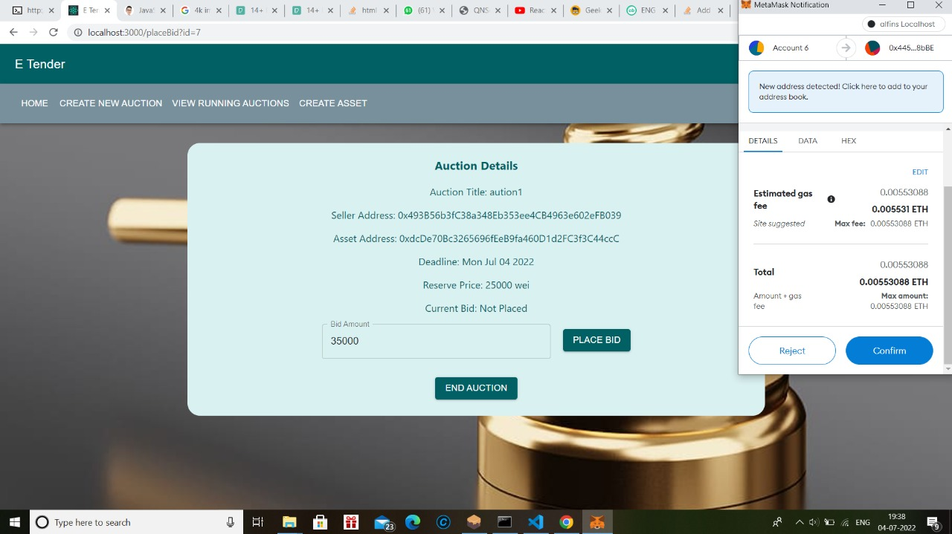
Placing bids

Slide 12
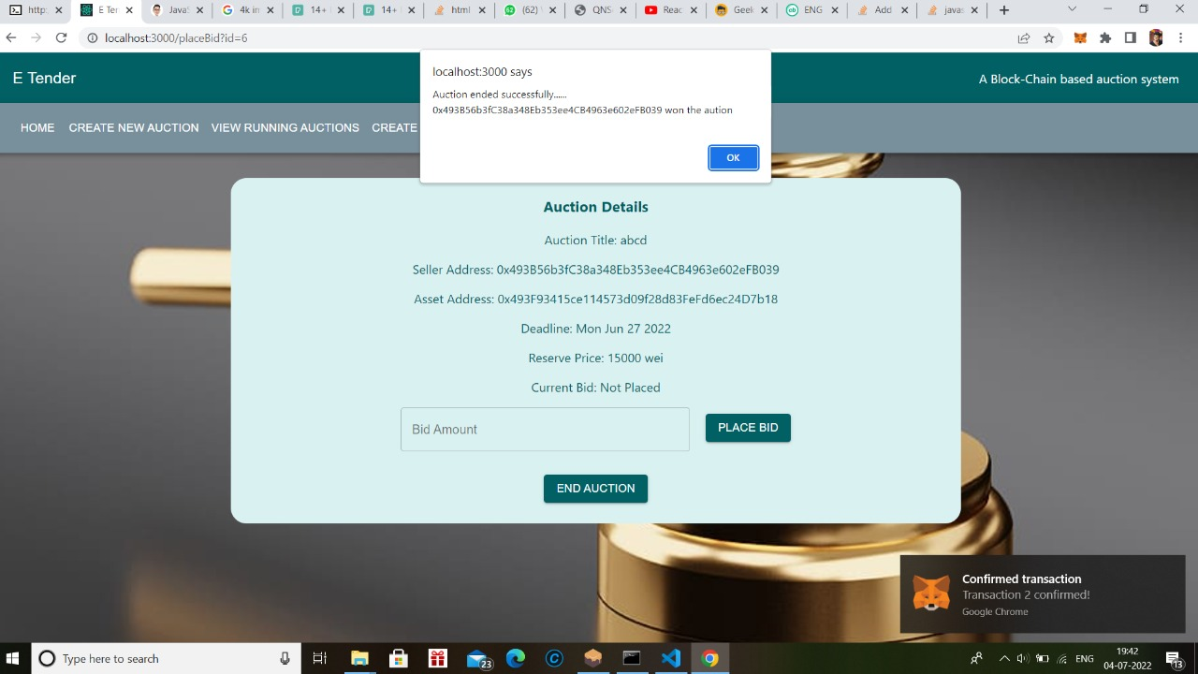
Auction Allocation

Slide 13
Thank You!!!

